Slide 1


Aayush Chaurasia
March 12, 2025

Slide 2

Outline
Executive Summary
Introduction
Methodology
Results
Conclusion
Appendix

Slide 3
Executive Summary
For analysis on SpaceX past launches along with creating a predictive model and an interactive dashboard involves the following steps:
Data collection using SpaceX API and web scraping from Falcon9 wiki page.
Data wrangling and visualization using pandas and seaborn respectively. SQL queries also helped to understand the data in great detail. Folium helped to understand the geospatial data of SpaceX launch sites.
Creating classification models using Logistic Regression, SVM, Decision Tree and KNN.
Created a dashboard using ‘plotly dash’ to give the data insights a presentable view to the target audience.
Summary of all results

Slide 4
Introduction
The commercial space age is here and companies are investing in space projects to make space travel convenient and affordable to the audience. There are several companies like Blue Orbital, Virgin Galactic and Rocket Lab working hard to make satellite providers and reusable rockets.
However, “SpaceX” founded by billionaire industrialist ‘Elon Musk’ is one of the top companies among them who have a steady growth in their space missions with one of their popular projects called `Falcon 9`.
Our company “SpaceY” is trying to analyze the landing success probability of first stage rockets based on the data gathered from “SpaceX” sites in order to take a decision for future space projects for our company.
To solve this problem, we need to address the following questions:
How many landing sites are there in this project?
Which landing sites have the most successful landings?
How factors like boosters, payload mass affects the landing success?

Slide 5

Section 1

Slide 6
Methodology
Executive Summary
Data collection methodology:
For collection of data we used SpaceX API endpoint (api.spacexdata.com/v4/) with data about cores, rockets and their past launches via web scraping tools.
Perform data wrangling
The collected data consists “Flight Number”, “Date”, “Booster Version”, “Payload Mass”, “Orbit”, “Launch Site” and “Outcome”. We will convert “Outcome” as target binary class data (0 or 1). The remaining data will be transformed as numerical data with standardization.
Perform exploratory data analysis (EDA) using visualization and SQL
Perform interactive visual analytics using Folium and Plotly Dash
Perform predictive analysis using classification models
We used various classification models including “Logistic Regression”, “Support Vector Classifier”, “Decision Tree Classifier” and “KNN” with best hyperparameters using “Grid Search CV” to pick the best model among them.

Slide 7
Data Collection
For data collection, we used SpaceX REST API endpoint along with web scraping libraries like ”BeautifulSoup” to collect data on rockets, past launches and other details to get insights on Falcon9 space missions.
The API had several endpoints:
/cores: Details about the rocket cores.
/rockets: Details about their rockets, with booster types and versions.
/past: This contained data about their past launches with their corresponding dates.
The data was scraped as HTML format which was later converted as pandas dataframe format which is a 2-dimensional tabular data.

Slide 8
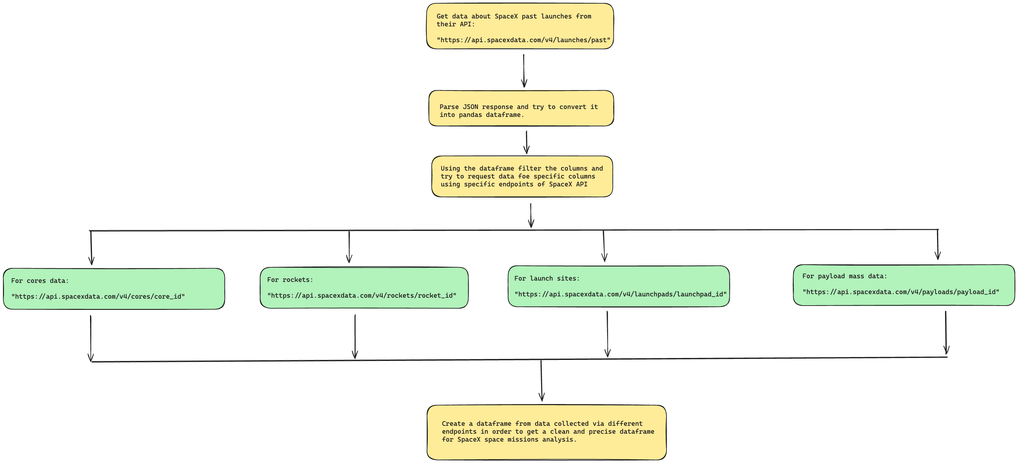
Data Collection – SpaceX API
First we got data on past launches from ‘/past’ endpoint.
Then using the parsed data we’ll request data from different endpoints by passing the unique id that was there in the parsed data.
We will parse data from:
/cores
/payloads
/rockets
/launchpads
For reference, check out the jupyter notebook on this GitHub repo.
Place your flowchart of SpaceX API calls here

Slide 9
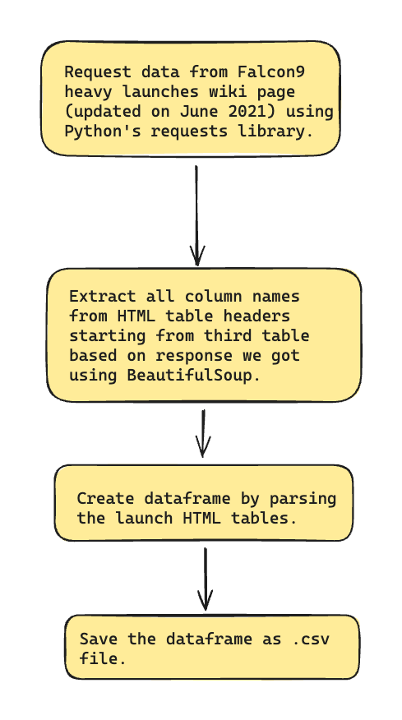
Data Collection - Scraping
Using ‘requests’ library get the data from wiki page and scrape the text response using beautifulsoup.
Then extract the column names from table headers starting from the third table.
For complete process of data collection via scraping, checkout the GitHub repo.
Place your flowchart of web scraping here

Slide 10
Data Wrangling
First, we will check the missing values and data types of columns in the dataframe.
Check for counts for the following:
Number of launches on each site.
Number and occurrence of each orbit.
Number of occurrence of mission of the orbits.
Create a landing outcome label from Outcome column which will be our target variable.

Slide 11
EDA with Data Visualization
For visualizing relationship between two variables, we used scatter plots for:
Payload Mass vs Flight Number
Launch Site vs Flight Number
Launch Site vs Payload Mass
Orbit vs Flight Number
Orbit vs Payload Mass
For relationship between success rate and orbit, bar graph was used.
To visualize launch success yearly trend we used line plot.
For reference, checkout the GitHub repo.

Slide 12
EDA with SQL
Displayed the names of unique launch sites in the space mission.
Displayed the first five launch sites starting with ‘CCA’.
Displayed total and average payload mass carried by boosters launched by NASA (CRS).
Listed the date when first successful landing was achieved.
Listed the names of boosters which have success in drone ship and have payload mass between 4000 and 6000.
Listed total number of successful and failed mission outcomes.
Displayed the names of booster versions which have carried maximum payload mass.
Displayed monthly failed missions in the year 2015.
Displayed the count of failure (drone ship) and success (ground pad) between dates 2010-06-04 and 2017-03-20 in descending order.

Slide 13
Build an Interactive Map with Folium
Summarize what map objects such as markers, circles, lines, etc. you created and added to a folium map
Explain why you added those objects
Add the GitHub URL of your completed interactive map with Folium map, as an external reference and peer-review purpose

Slide 14
Build a Dashboard with Plotly Dash
Summarize what plots/graphs and interactions you have added to a dashboard
Explain why you added those plots and interactions
Add the GitHub URL of your completed Plotly Dash lab, as an external reference and peer-review purpose

Slide 15
Predictive Analysis (Classification)
Summarize how you built, evaluated, improved, and found the best performing classification model
You need present your model development process using key phrases and flowchart
Add the GitHub URL of your completed predictive analysis lab, as an external reference and peer-review purpose

Slide 16
Results
Exploratory data analysis results
Interactive analytics demo in screenshots
Predictive analysis results

Slide 17

Section 2

Slide 18
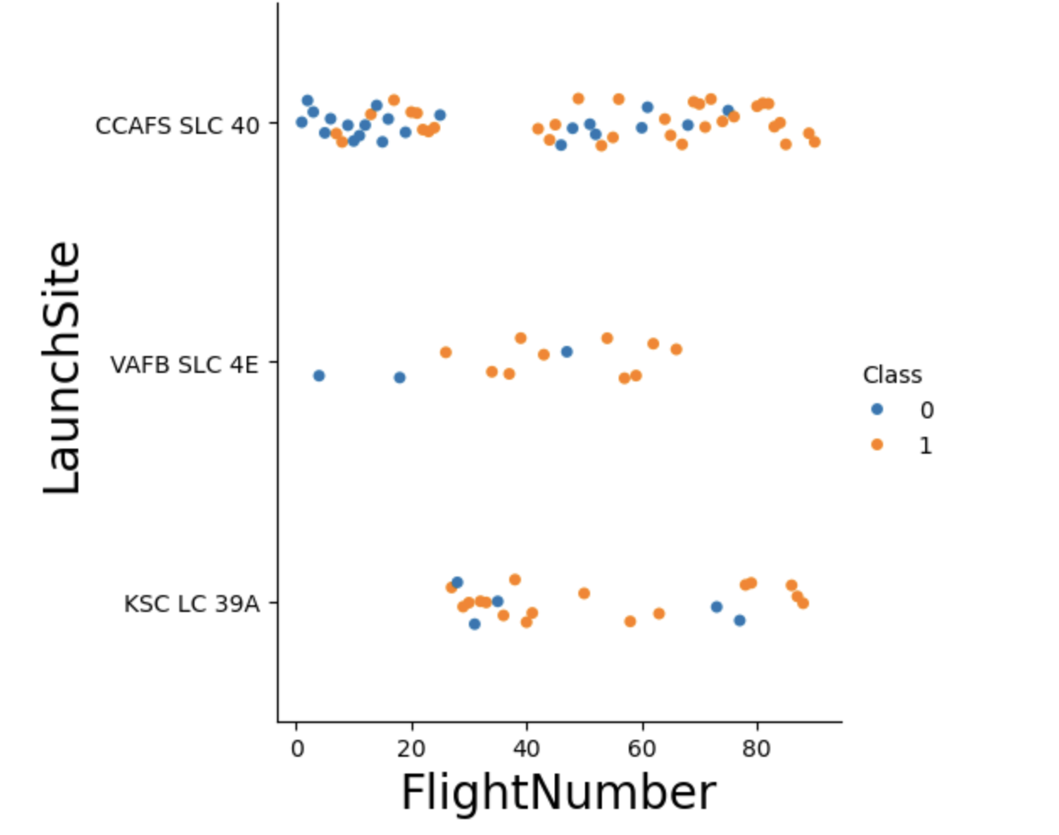
Flight Number vs. Launch Site
The scatter plot on the right demonstrates the relation between LaunchSite and FlightNumber.
Here the scatterplot is colored on the basis of mission outcome (0 for failure and 1 for success).
As we can see the patterns in the plot shows that the chances of successful landing gets increased as the flight number increases.
This is because due to failed missions in the past, they are trying to mitigate the drawbacks that have happened in the past space missions in their first stages.

Slide 19
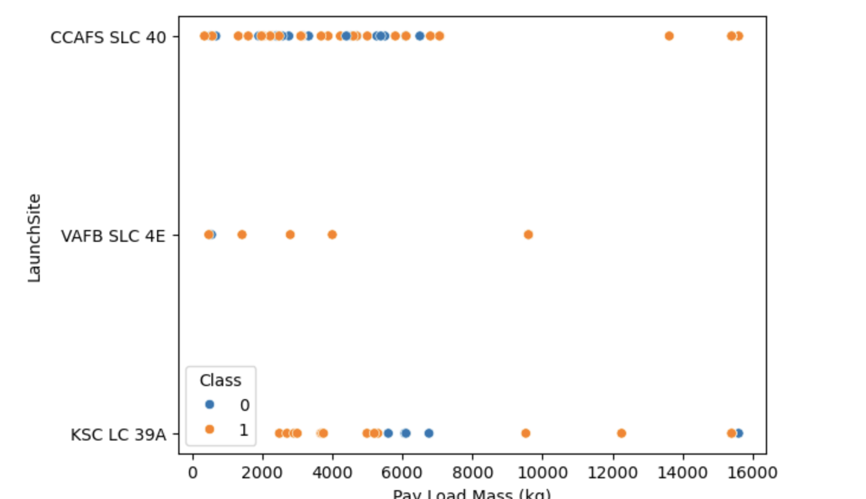
Payload vs. Launch Site
The scatter plot on the right demonstrates the relation between LaunchSite and Payload Mass (kg).
In this, we can see that for launch site ‘VAFB SLC 4E’, there were no heavy rockets with payload mass greater than 10000.
For other launch sites the payload mass has gone upto 16000.

Slide 20
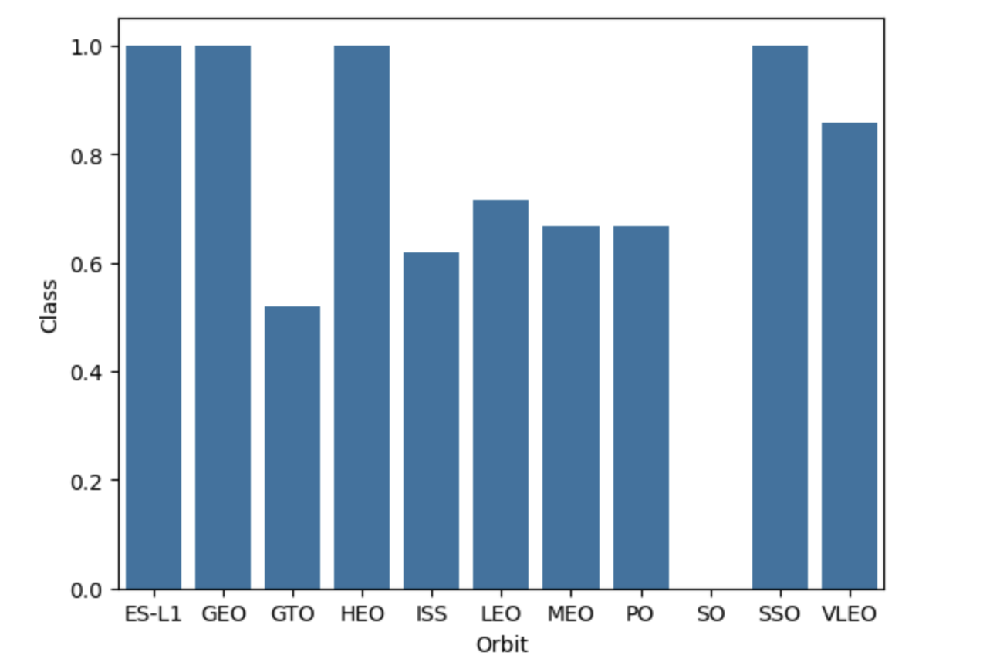
Success Rate vs. Orbit Type
The plot on the right demonstrates the relation between Landing Outcome and Orbit.
As we can see, the following orbits have the highest success rates:
ES-L1
GEO
HEO
SSO
GTO has the lowest success rate.

Slide 21
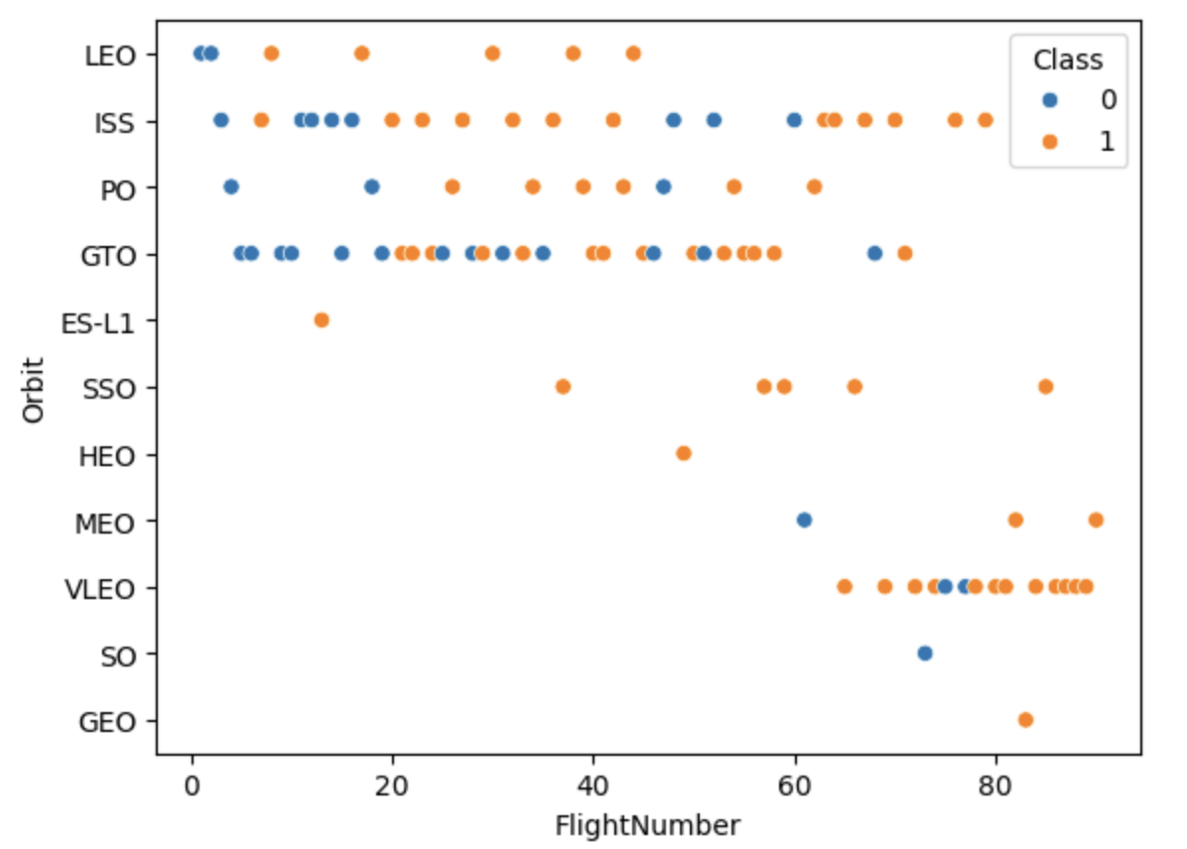
Flight Number vs. Orbit Type
The plot on the right shows relation between Orbit and FlightNumber.
Here, in case of LEO orbit, success rate seems to be related to the number of flights.
On the other hand, in case of GTO there is no relation.

Slide 22
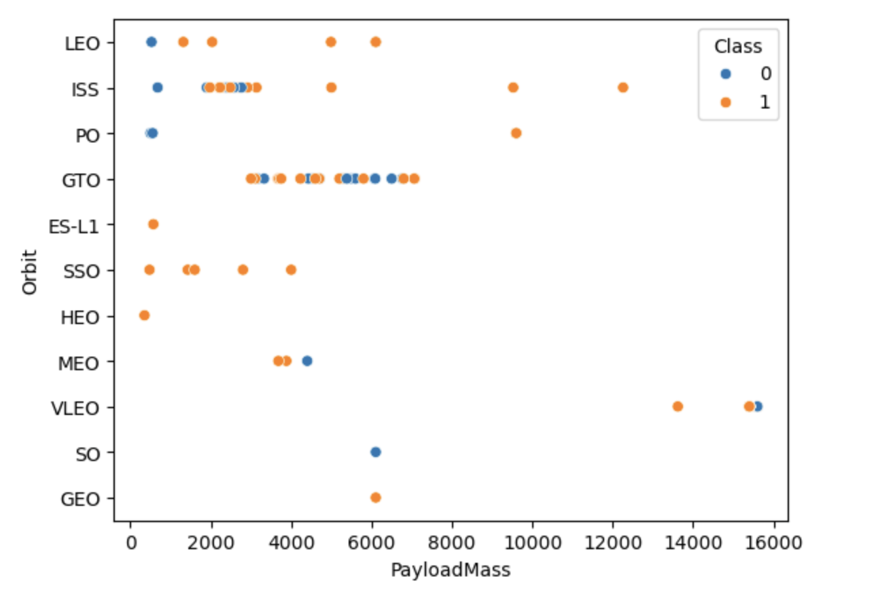
Payload vs. Orbit Type
The plot shows the relation between Orbit and Payload Mass.
As we can see, heavier payload mass rockets have more chances of being successful in case of LEO, PO and ISS orbits.
Orbits SO and GEO have the least number of rockets with only one rocket with payload mass of 6000.

Slide 23
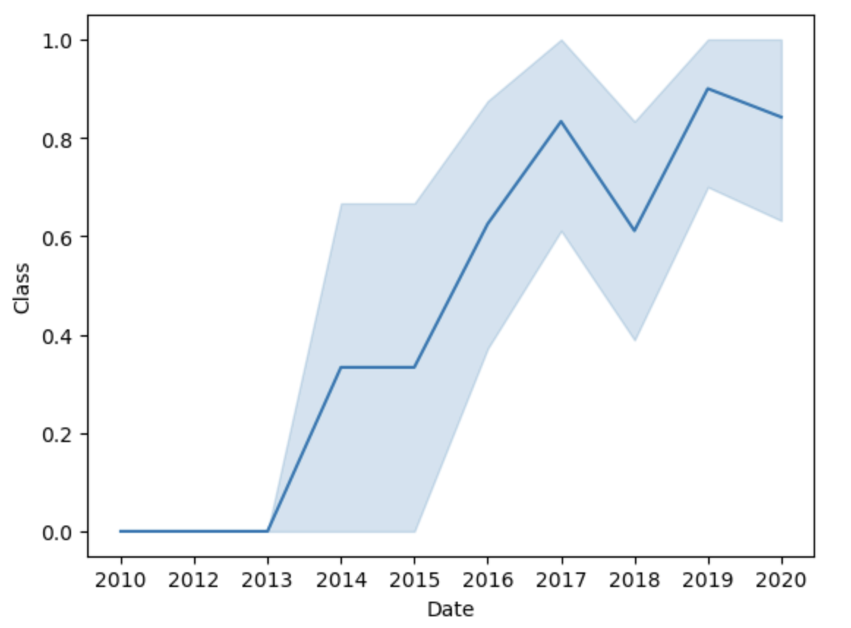
Launch Success Yearly Trend
Shows relationship between Landing Outcome and Date of launch.
This shows that the success rate kept increasing since 2013 till 2020.
There is a sudden rise in success rate after 2013.

Slide 24
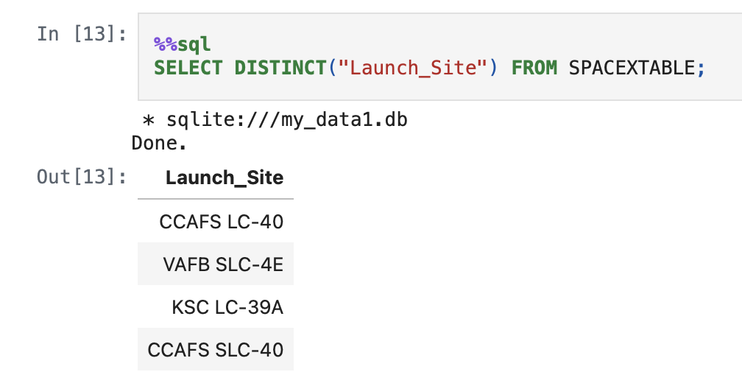
All Launch Site Names
This query displays the unique names of launch sites from the SPACEXTABLE.
The result shows total 4 unique launch sites.

Slide 25
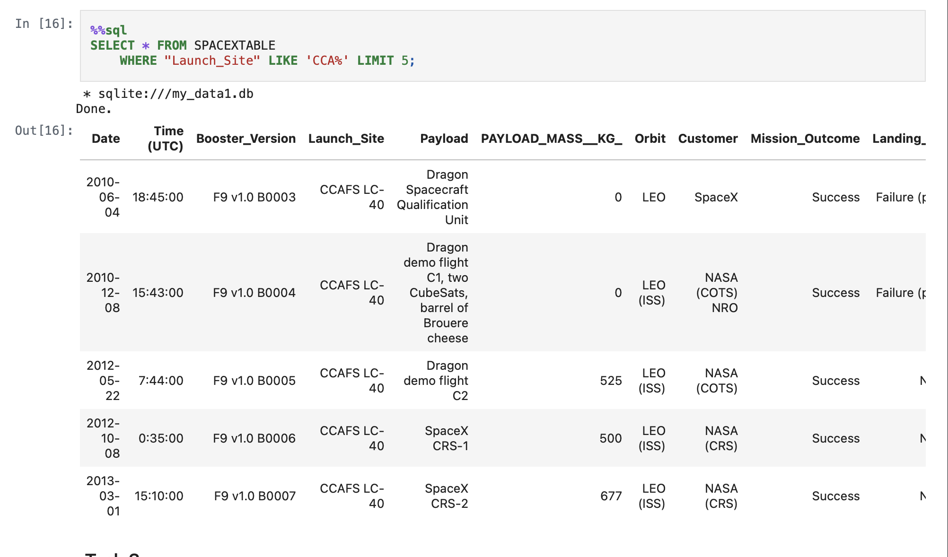
Launch Site Names Begin with 'CCA'
This query displays the top 5 rows from the SPACEXTABLE where launch site starts with ‘CCA’.
The result shows two launches in 2010, two in 2012 and one in 2013.

Slide 26
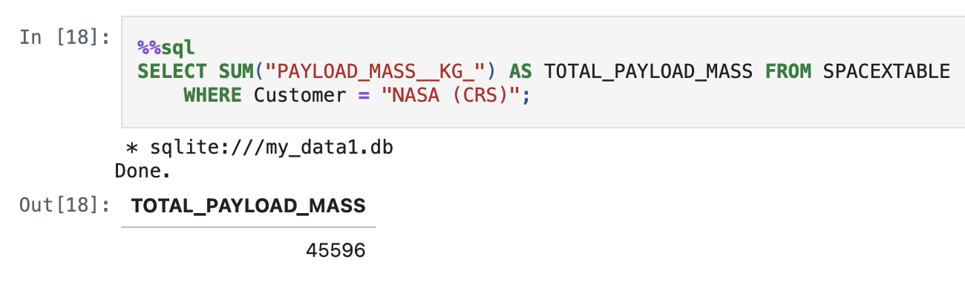
Total Payload Mass
This query sums all the payload masses from the SPACEXTABLE, where Customer is ‘NASA (CRS)’.
The total payload mass is 45596.

Slide 27
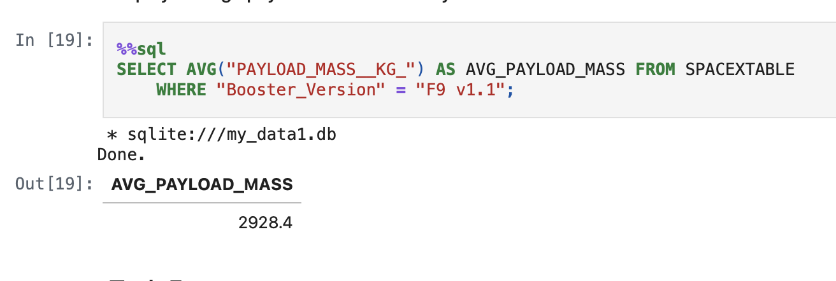
Average Payload Mass by F9 v1.1
Here, we try to calculate mean of payload mass with an alias as AVG_PAYLOAD_MASS from SPACEXTABLE for booster version ‘F9 v1.1’.
The average comes around 2928.4 kg.

Slide 28
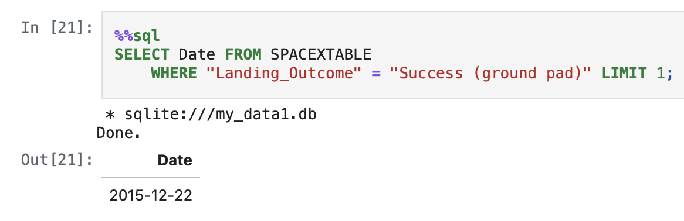
First Successful Ground Landing Date
Displays the top 1 row where landing outcome is ‘success (ground pad)’.
The first successful ground landing date was on 22nd Dec., 2015.

Slide 29
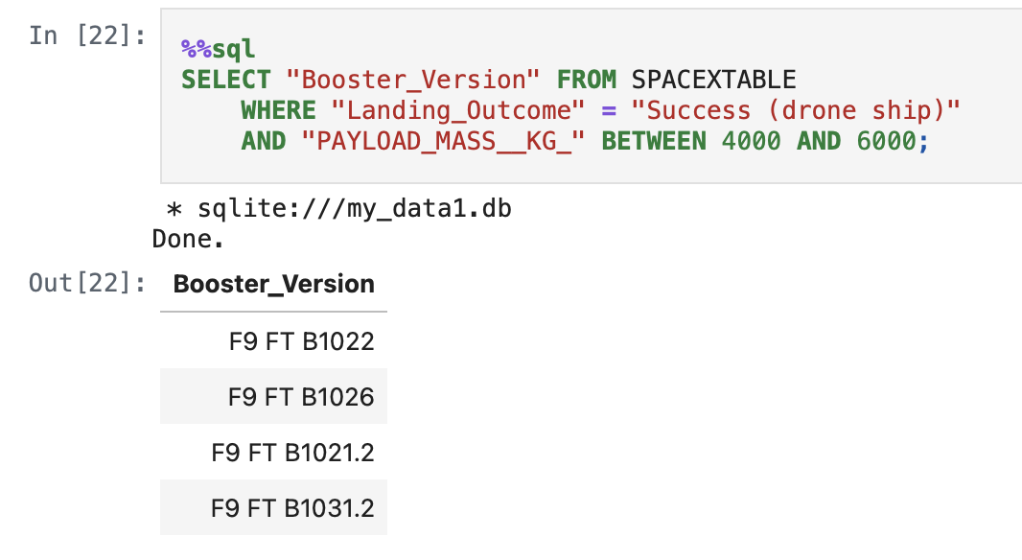
Successful Drone Ship Landing with Payload between 4000 and 6000
The booster versions: “F9 FT B1022”, “F9 FT B1026”, “F9 FT B1021.2” and “F9 FT B1031.2” have successful drone ship landing with payload between 4000 and 6000.

Slide 30
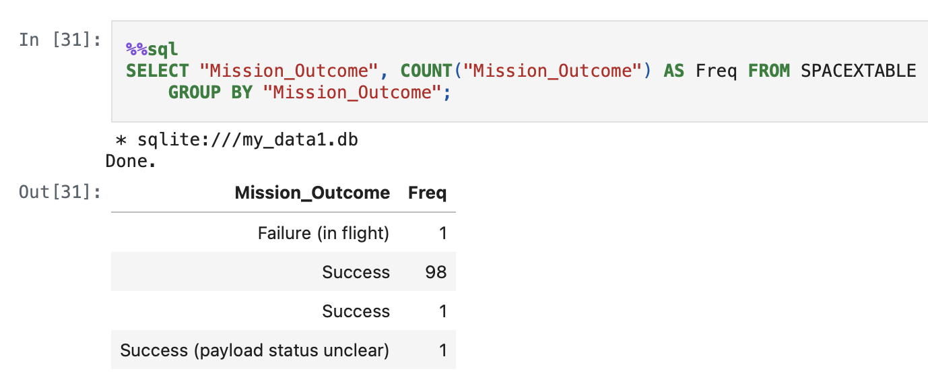
Total Number of Successful and Failure Mission Outcomes
First, we will group the table on the basis of mission outcome followed by displaying mission outcome and their corresponding counts.
We can say that no. successes = 100 and failure = 1.

Slide 31
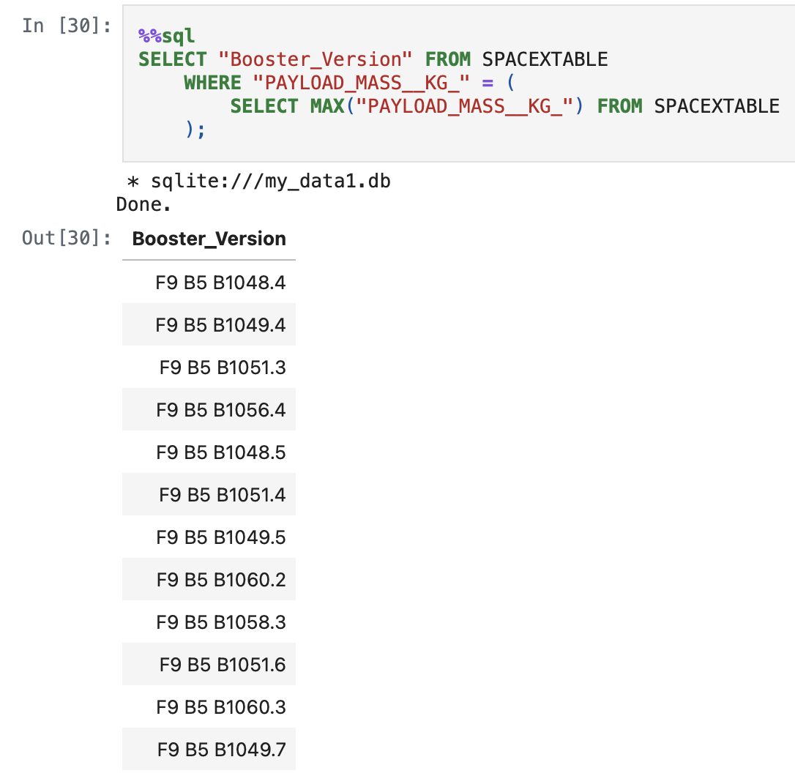
Boosters Carried Maximum Payload
There are several boosters which have carried maximum payload mass in their space missions.

Slide 32
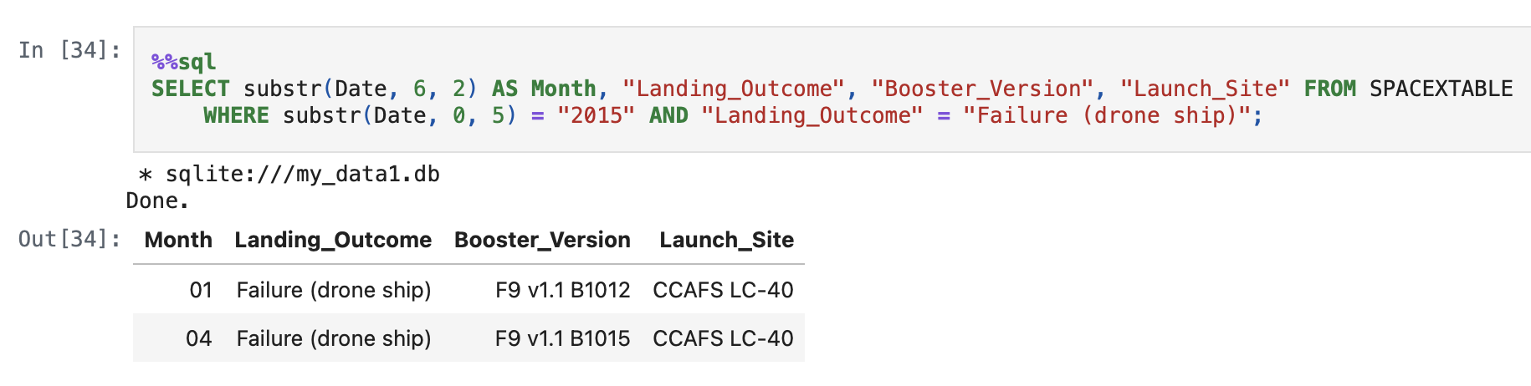
2015 Launch Records
Here it is evident that in the year 2015, there were two failed drone ship missions happened in the months of January and April.
These two failures happened at the same launch site.

Slide 33
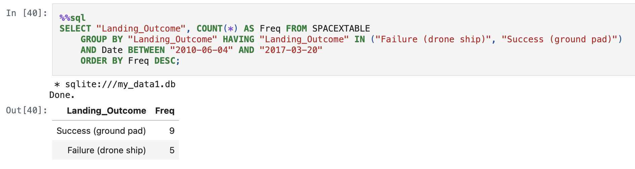
Rank Landing Outcomes Between 2010-06-04 and 2017-03-20
This shows that the success landing on ground pad has the highest frequency followed by failure of drone ships.

Slide 34

Section 3

Slide 35
<Folium Map Screenshot 1>
Replace <Folium map screenshot 1> title with an appropriate title
Explore the generated folium map and make a proper screenshot to include all launch sites’ location markers on a global map
Explain the important elements and findings on the screenshot

Slide 36
<Folium Map Screenshot 2>
Replace <Folium map screenshot 2> title with an appropriate title
Explore the folium map and make a proper screenshot to show the color-labeled launch outcomes on the map
Explain the important elements and findings on the screenshot

Slide 37
<Folium Map Screenshot 3>
Replace <Folium map screenshot 3> title with an appropriate title
Explore the generated folium map and show the screenshot of a selected launch site to its proximities such as railway, highway, coastline, with distance calculated and displayed
Explain the important elements and findings on the screenshot

Slide 38

Section 4

Slide 39
<Dashboard Screenshot 1>
Replace <Dashboard screenshot 1> title with an appropriate title
Show the screenshot of launch success count for all sites, in a piechart
Explain the important elements and findings on the screenshot

Slide 40
<Dashboard Screenshot 2>
Replace <Dashboard screenshot 2> title with an appropriate title
Show the screenshot of the piechart for the launch site with highest launch success ratio
Explain the important elements and findings on the screenshot

Slide 41
<Dashboard Screenshot 3>
Replace <Dashboard screenshot 3> title with an appropriate title
Show screenshots of Payload vs. Launch Outcome scatter plot for all sites, with different payload selected in the range slider
Explain the important elements and findings on the screenshot, such as which payload range or booster version have the largest success rate, etc.

Slide 42

Section 5

Slide 43
Classification Accuracy
Visualize the built model accuracy for all built classification models, in a bar chart
Find which model has the highest classification accuracy

Slide 44
Confusion Matrix
Show the confusion matrix of the best performing model with an explanation

Slide 45
Conclusions
Point 1
Point 2
Point 3
Point 4
…

Slide 46
Appendix
Include any relevant assets like Python code snippets, SQL queries, charts, Notebook outputs, or data sets that you may have created during this project

Slide 47


